Slide 1

Basic Web Development
ITSM-101

Slide 2
Outline of Course
Introduction to HTML
HTML Elements and attributes
CSS
JavaScript
JQuery

Slide 3
HTML
Chapter (1)
Hyper Text Markup Language

Slide 4
Introduction to HTML
HTML is the set of markup symbols or codes placed in a file that is intended for display on a web page.
Each individual markup code is referred to as an element, or tag.
Each tag has a purpose. Tags are enclosed in angle brackets, the < and > symbols.
Most tags come in pairs: an opening tag and a closing tag.

Slide 5
Document Type Definition (DTD)
Markup language used in a web page document with a Document Type Definition (DTD).
The DTD identifies the version of HTML contained in your document.
The DTD statement, commonly called a doctype statement, is placed at the top of a web page document.

Slide 6
Web Page Template
Every single web page you create will include the DTD and the html, head, title, meta, and body elements.
<! DOCTYPE html >
< html lang="en" >
< head >
< title>Page Title Goes Here</title >
< meta charset="utf-8" >
< /head >
< body > ... body text and more HTML tags go here ...
< /body >
< /html >

Slide 7
HTML Element
to indicate the document is HTML formatted
tells the browser how to interpret the document
opening <html> tag is placed on a line below the DTD.
closing </html> tag indicates the end of the web page and is placed after all other HTML elements in the document.
also needs to indicate the spoken language, such as English, of the text in the document.
lang attribute specifies the spoken language of the document.
For example, lang="en" indicates the English language. Search engines and screen readers may access this attribute.

Slide 8
Head, Title, Meta, and Body Elements
There are two sections on a web page: the head and the body.
The head section contains information that describes the web page document.
The body section contains the actual tags, text, images, and other objects that are displayed by the browser as a web page.

Slide 9
The Head Section
In the head section, include the title of the web page, meta tags that describe the document (such as the character encoding used and information that may be accessed by search engines), and references to scripts and styles.
Many of these features do not show directly on the web page.
The head element contains the head section, which begins with the <head> tag and ends with the </head> tag.
In the head section, always code at least two other elements in the head section: a title element and a meta element.

Slide 10
title element & meta element
The title element configures the text that will appear in the title bar of the browser window.
The text between the <title> and </title> tags is called the title of the web page and is accessed when web pages are bookmarked and printed.
The meta element describes a characteristic of a web page, such as the character encoding.

Slide 11
Character encoding
It is the internal representation of letters, numbers, and symbols in a file such as a web page or other file that is stored on a computer and may be transmitted over the Internet.
There are many different character-encoding sets. However, it is common practice to use a character-encoding set that is widely supported, such as utf-8, which is a form of Unicode (http://www.unicode.org).
The meta tag uses the charset attribute to indicate the character encoding. An example meta tag is as follows:
< meta charset="utf-8" >

Slide 12
The Body Section
contains text and elements that display directly on the web page in the browser window,
also referred to as the browser viewport
the purpose of the body section is to configure the contents of the web page

Slide 13
Sample HTML
<!DOCTYPE html>
<html lang="en">
<head>
<title>My first web page </title>
<meta charset="utf-8">
</head>
<body>
Hello UCSY
</body>
</html>

Slide 14

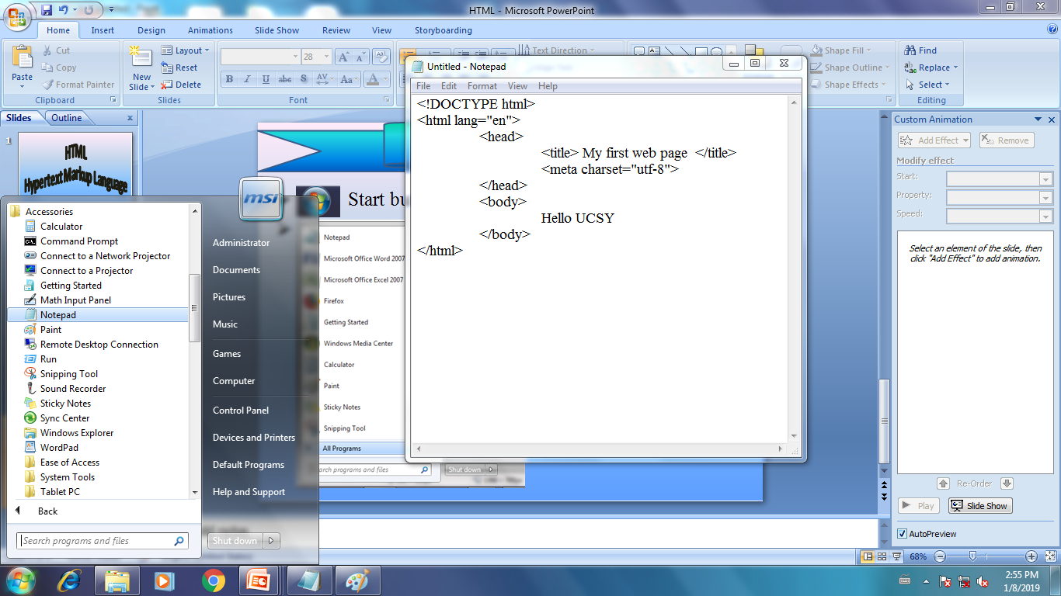
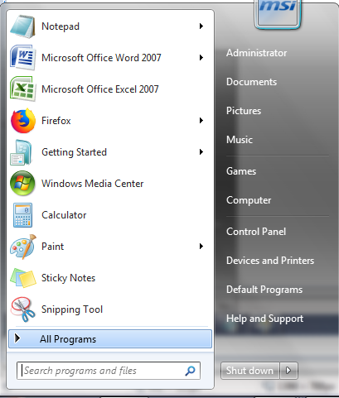
How to Start Notepad
1
Start
3
2

Slide 15
How to Save?
ဥပမာ။ ။D အောက်ရှိ folder တွင် သိမ်းမည် ဆိုပါက
File Save D:yourfolder filename.html
File Save As D:yourfolder
Sample Code
သတိပြုရန်။ file extension ကို html (သို့) htmဖြင့်ပေးရမည် ဖြစ်သည်။
newfilename.html

Slide 16

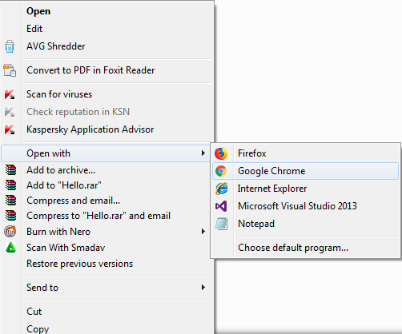
How to run the code?
1. Right Click on your file name and go to "Open with".
2. Choose browser name.

Slide 17


Display output
<title> My first web page </title>
<body> Hello UCSY </body>
File path လမ္းေၾကာင္းကို ျပေနတာ

Slide 18
Body Element in HTML
body Attributes
background – (Image) | .jpg / .jpeg / .png / .gif
bgcolor- (Color) | အ ေရာင္ အမည္ (red ..)
text - စာသား အားလံုး အေရာင္
link
alink (active link)
vlink (visited link)
<body bgcolor="black" text="white">
Hello UCSY
</body>

Slide 19
Heading Element
Six levels: h1 through h6
The size of the text is largest for <h1> …… </h1>
The size of the text is smallest for <h6> ……. </h6>
All text contained within heading tags is displayed with bold font weight.
right / left(default) / center / justify
Heading Attributes- align
<body>
<h1 align="right"> ………. </h1>
</body>

Slide 20
Sample code
<!DOCTYPE html>
<html lang="en">
<head>
<title> Heading Example</title>
<meta charset="utf-8">
</head>
<body>
<h1> Heading Level 1</h1>
<h2> Heading Level 2</h2>
<h3> Heading Level 3</h3>
<h4> Heading Level 4</h4>
<h5> Heading Level 5</h5>
<h6> Heading Level 6</h6>
</body>
</html>

Slide 21
Paragraph Element
Paragraph elements are used to group sentences and sections of text together.
Text that is contained by <p> and </p> tags.
right / left(default) / center / justify
Paragraph Attributes- align
<body>
<p align="right"> ………. </p>
</body>

Slide 22
Sample code
<!DOCTYPE html>
<html lang="en">
<head>
<title> Paragraph Example</title>
<meta charset="utf-8">
</head>
<body>
<h1> Heading Level 1</h1>
<p> This is a sample paragraph. Heading tags can help to make your pages more accessible and usable. </p>
<p align="right"> Paragraph 1</p>
<p align="center"> Paragraph 2</p>
<p align="left"> Paragraph 2</p>
<p> Paragraph 3</p>
</body>
</html>

Slide 23
Line Break Element
The line break element causes the browser to advance to the next line before displaying the next element or portion of text on a web page.
Not coded as a pair of opening and closing tags.
It is considered to be a stand-alone element.
Line break tag is coded as <br>

Slide 24
Sample code
<!DOCTYPE html>
<html lang="en">
<head>
<title>HTML br Tag</title>
</head>
<body>
<p>This is before the line break<br /> and this after the line break.</p>
</body>
</html>

Slide 25
Blockquote Element
The blockquote element is used to display a block of quoted text in a special way- indented from both the left and right margins.
<blockquote> ………</blockquote>
Phrase Element
Logical style elements
Indicate the context and meaning of the text between the container tags.
It used to indicate that a block of text has structural meaning

Slide 26
Phrase Element
<abbr title="Description"> abbreviation </abbr> | Identifies text as an abbreviation
<b> … </b> | Bold text
<strong> … </strong> | strong text (bold)
<em> … </em> | emphasized text
<i> … <i> | (italics)
<mark> … </mark> | mark text (HTML5 only)
<small> … </small> | small text
<big> … </big> | big text
<sup> … </sup> | sup text
<sub> … </sub> | sub text

Slide 27
<cite>.... </cite> | used to mention any creative work. Useful from books to paintings, the <cite> tag requires that when you designate the URL or title of the work.
<code> . ....</code> | used to designate that a section of text is computer code.
<dfn> </dfn> definition element | used to represent the defining instance of a term. This tag has an order of operations of sorts when it comes to usage;.
<kbd> </kbd> | used to designate that a section of text is keyboard input.
<samp> </samp> | to designate sample output from a computer. It is usually shown in the browser's default monotype font.
<var> </var> | used to designate a variable. It is useful when you are writing a page that deals with programming or mathematical expressions.

Slide 28
Sample code
<!DOCTYPE html>
<html lang="en">
<head>
<title> Blockquote Example</title>
<meta charset="utf-8">
</head>
<body>
<h1> The Power of the Web</h1>
<p>According to Tim Berners-Lee, the inventor of the World Wide Web, at http://www.w3.org/WAI/: </p>
<blockquote>
The power of the Web is in its universality. Access by everyone regardless of disability is an essential aspect.
</blockquote>
</body>
</html>

Slide 29
Sample code
<!DOCTYPE html>
<html lang="en">
<head>
<title> Phrase Example</title>
<meta charset="utf-8">
</head>
<body>
<h1> The Power of the Web</h1>
<p>According to Tim Berners-Lee, the inventor of the World Wide Web, at http://www.w3.org/WAI/: </p>
<em> It is emphasized text </em>
H <sub> 2 </sub> O
A <sup> 2 </sup> + B <sup> 2 </sup>
</body>
</html>

Slide 30
Sample code
<!DOCTYPE html>
<html lang=“en”>
<head>
<title> Phrase Tag Example</title>
<meta charset="utf-8">
</head>
<body>
<p>Michelangelo sculpted <cite>David</cite> between 1501 and 1504.</p>
The <abbr title="Central Processing Unit">CPU</abbr> ran hot.
<p>The first part of this sentence is normal text,<br>
<code>and the second is formatted with the &lt;code&gt; tag.</code></p>
<p><dfn>Computer Hope</dfn> is a computer help website.</p>
<p>Here is a regular sentence that has <kbd>a bit of keyboard
input</kbd> contained within it.</p>
<p>Normal text. <samp>Sample text.</samp> Normal text.</p>
<p>Example of a regular sentence that has a <var>variable</var> contained within it.</p>
</body>
</html>

Slide 31
Unordered List
An unordered list displays a bullet, or list marker, before each entry in the list. Begins with a <ul> tag and end with a </ul> tag.
Each list item begins with an <li> tag and ends with an </li>
<body>
<h1> Popular web server</h1>
<ul type="circle">
<li> Apache Web server</li>
<li> Microsoft IIS</li>
<li> Oracle iPlanet Web Server</li>
</ul>
</body>
Attributes - type
disc (default)
square
circle

Slide 32
Sample code
<!DOCTYPE html>
<html lang="en">
<head>
<title> Heading and List</title>
<meta charset="utf-8">
</head>
<body>
<h1> Popular Web Server</h1>
<ul>
<li> Apache Web server</li>
<li> Microsoft IIS</li>
<li> Oracle iPlanet Web Server</li>
</ul>
</body>
</html>

Slide 33
Ordered List
An ordered list displays a numbering or lettering system to itemize the information contained in the list.
Begin with an <ol> tag and end with an </ol>tag.
Each list item begins with an <li> tag and ends with an </li>
Attributes - type
1 Numerals
A Uppercase
a Lowercase
I Uppercase Roman
i Lowercase Roman
<body>
<h1> Popular web server</h1>
<ol type="a" start="5">
<li> Apache Web server</li>
<li> Microsoft IIS</li>
<li> Oracle iPlanet Web Server</li>
</ol>
</body>
Attributes - start

Slide 34
Sample code
<!DOCTYPE html>
<html lang="en">
<head>
<title> Heading and List</title>
<meta charset="utf-8">
</head>
<body>
<h1> Popular Web Server</h1>
<ol>
<li> Apache Web server</li>
<li> Microsoft IIS</li>
<li> Oracle iPlanet Web Server</li>
</ol>
</body>
</html>

Slide 35
Description List
Begin with the <dl> tag and end with the </dl> tag.
Each term or name in the list begins with the <dt> tag and ends with the </dt> tag.
Each description begins with the <dd> tag and ends with the </dd> tag.

Slide 36
Sample code
<!DOCTYPE html>
<html lang="en">
<head>
<title> Heading and List</title>
<meta charset="utf-8">
</head>
<body>
<dl>
<dt> TCP </dt>
<dd> Transmission Control Protocol is a method (protocol) … </dd>
<dt> FTP </dt>
<dd> File Transfer Protocol is a method (protcol) …. </dd>
</dl>
</body>
</html>

Slide 37
Special Characters
Double Quotation mark | &quot;
Single Quotation mark | &rsquo;
Copyright @ | &copy;
Less than | &lt;
Greater than | &gt;
Ampersand | &amp;
Heart ♥ | &hearts;
Blank space | &nbsp;
Logn dash | &mdash;

Slide 38
Sample code
<!DOCTYPE html>
<html lang="en">
<head>
<title> Special character ,Phrase, Paragraph </title>
<meta charset="utf-8">
</head>
<body>
<h1>Trillium Media Design</h1>
<p> Home &nbsp; Services &nbsp;Contact</p>
<h2> New Media and Web Design</h2>
<p> Trillium Media Design will bring your company &rsquo; Web presence to the next level. We offer a comprehensive range of services.</p>
<h2>Meeting Your Business Needs</h2>
<p> Our expert designers are creative and eager to work with you. Take advantage of the power of Web 2.0!</p>
<p> <small> Copyright &copy; 2012 Your name here</small></p>
</body>
</html>

Slide 39
Division Element
The div element configures a structural block area, or "division", on a web page, with empty space above and below.
Begins with a <div>tag and ends with a </div>

Slide 40
Sample code
<!DOCTYPE html>
<html lang="en">
<head>
<title> Special character ,Phrase, Paragraph </title>
<meta charset="utf-8">
</head>
<body>
<h1>Trillium Media Design</h1>
<p> Home &nbsp; Services &nbsp;Contact</p>
<h2> New Media and Web Design</h2>
<p> Trillium Media Design will bring your company &rsquo;s Web presence to the next level. We offer a comprehensive range of services.</p>
<h2>Meeting Your Business Needs</h2>
<p> Our expert designers are creative and eager to work with you. Take advantage of the power of Web 2.0!</p>
<div> <small> Copyright &copy; 2012 Your name here</small></div>
</body>
</html>

Slide 41
Anchor Element
Use the anchor element to specify a hyperlink, as a link, to another web page or file
Begins with an <a> tag and ends with a </a>tag
Use the href attribute to configure the hyperlink reference, which identifies the name and location of the file to access.
<body>
<a href= http://www.webdevfoundations.net>
Web Development &amp; DesignFoundations
</a>
</body>

Slide 42
Absolute Hyperlinks
An absolute hyperlink indicates the absolute location of a resource on the Web.
Use absolute hyperlinks when you need to link to resources on other websites.
The href value for an absolute hyperlink to the home page of a website includes the http://protocol and the domain name.
<a href= "http://www.webdevfoundations.net">
Web Development &amp; Design Foundations
</a>

Slide 43
Sample code
<!DOCTYPE html>
<htmllang="en">
<head>
<title>Anchor Example</title>
<meta charset="utf-8">
</head>
<body>
<a href= "http://www.webdevfoundations.net">
Web Development &amp; Design Foundations
</a>
</body>
</html>

Slide 44
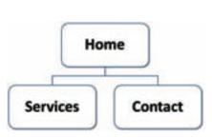
Relative Hyperlinks
When you need to link to web pages within your site, use a relative hyperlink.
The href value for a relative hyperlink does not begin with the http://does not include a domain name.
<body>
<a href="contact.html">Contact Us</a>
</body>
Contact.html ဖိုင်သည် ယခု html နှင့် folder တစ်ခုထဲ တွင် ရှိနေရမည်။

Slide 45
E-mail Hyperlinks
An anchor tag can also be used to create e-mail hyperlinks.
An e-mail link will automatically lunch the default mail program configured for the browser.
The href value of an e-mail link begins with mailto: followed by a valid e-mail address.
<body>
<a href="mailto:suwin01@gmail.com"> Email </a>
</body>

Slide 46
<nav> element
is used for declaring a navigational section of the HTML document
represents a section of a page whose purpose is to provide navigation links, either within the current document or to other documents.
common examples of navigation sections are menus, tables of contents, and indexes.
<address> element
indicates that the enclosed HTML provides contact information for a person or people, or for an organization.

Slide 47
<header> element
represents introductory content, typically a group of introductory or navigational aids. It may contain some heading elements but also a logo, a search form, an author name, and other elements.
<footer> element
represents a footer for its nearest sectioning content or sectioning root element. A footer typically contains information about the author of the section, copyright data or links to related documents.
<main> element
represents the dominant content of the <body> of a document. The main content area consists of content that is directly related to or expands upon the central topic of a document, or the central functionality of an application.

Slide 48
Sample code
<!DOCTYPE html>
<html lang=“en”>
<head>
<title> </title>
<meta charset=“utf-8”>
</head>
<body>
<header>
<h1>Cute Puppies Express!</h1>
</header>
<main>
<p>I love beagles <em>so</em> much! Like, really, a lot. They’re adorable and their ears are so, so snuggly soft!</p>
</main>
<footer>
<p>© 2018 Gandalf</p>
</footer></body></html>

Slide 49
Exercises for Chapter 1.

